Slide 1
Flutter
0
+1
NT213 Presentation
Petar Otovic 5460
-3

Slide 2
Table of contents
01
02
03
04
Dart programming language
Dart Deepdive
Flutter
Flutter Deepdive
+8

Slide 3
01
What is Dart?
+7
-5
-4

Slide 4

Dart
- Developed by Google
- Released in 2011
- Alternative to Javascript
- Just-in-time compiler
- Single isolate
.dart

Slide 5
Dart Deepdive
- Type safe
- Dynamic type
- Null safety
- Supports multiple paradigms
- Pub.dev

Slide 6
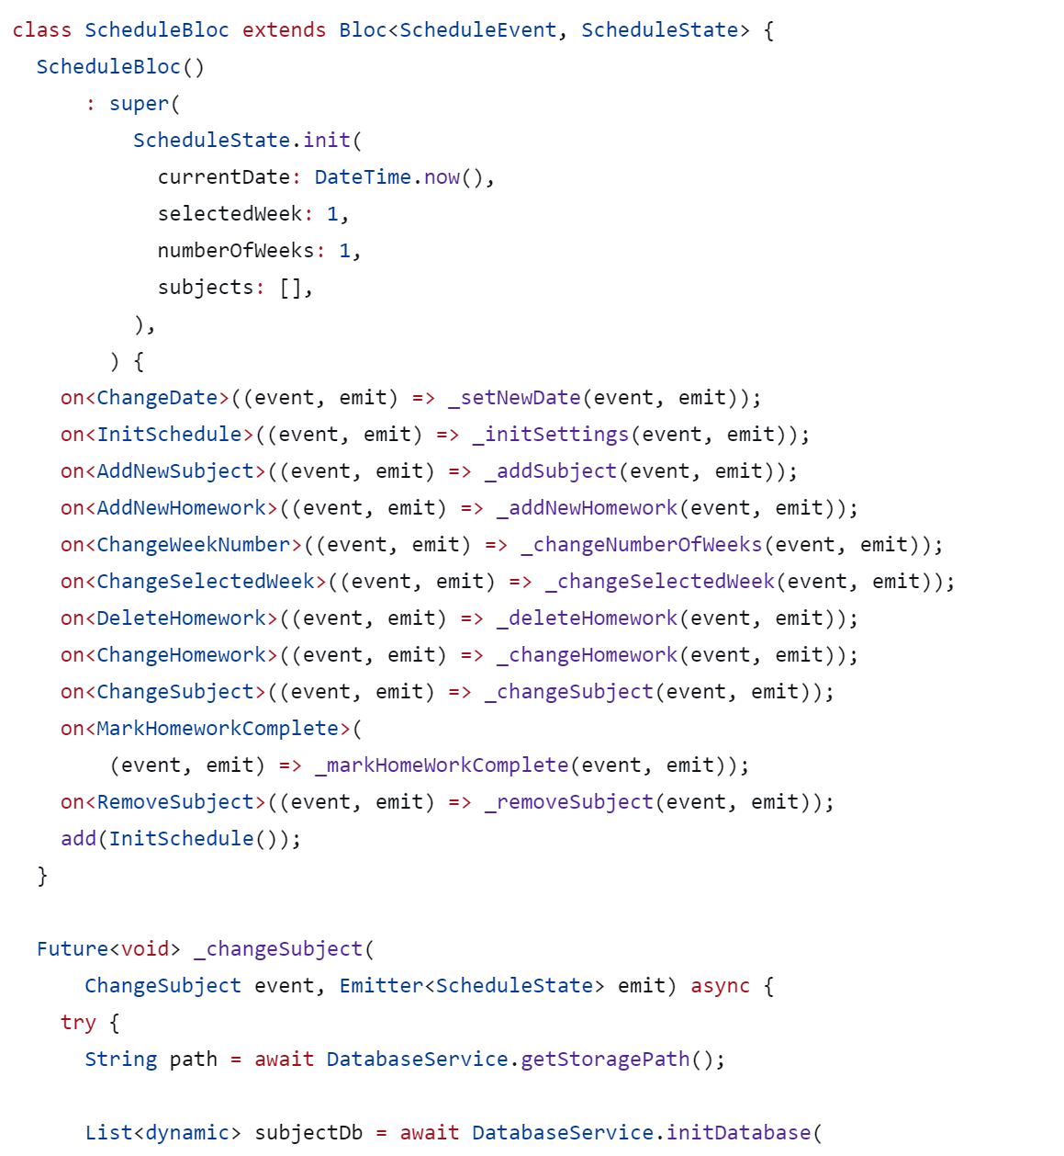
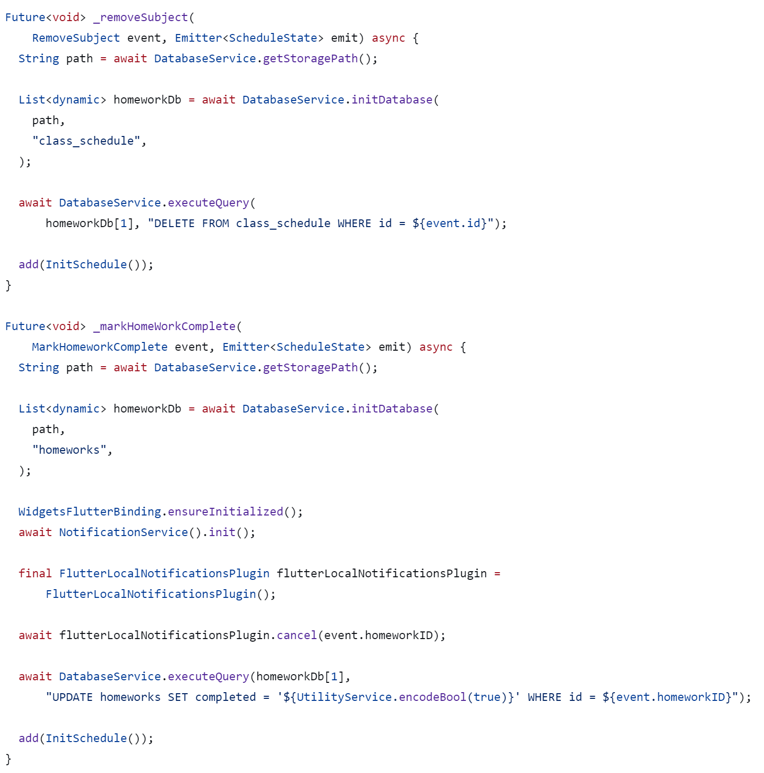
Dart Syntax

Slide 7
Flutter
- Framework for building UI
- Supports various different platforms
- Skia 2D graphics engine & Dart
- Introduced in 2017 by Google
- Supported by Google

Slide 8
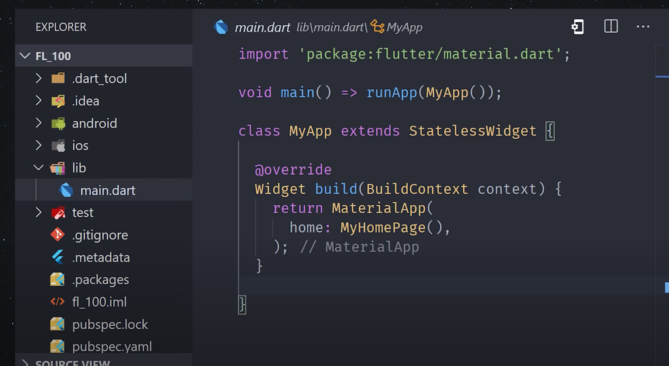
Flutter Deepdive
- Install Flutter SDK
- Init app
- Widgets
- Prebuilt widgets
- Custom widgets
- Stateless & Stateful

Slide 9
Flutter Pros
Pros:
- One codebase
- Many platforms
- Faster Development time
- Supported by Google
- Raising in popularity

Slide 10
Flutter Cons
- Platform updates
- Larger app size
- Limited native features
- Not so many job ads

Slide 11
Thank you

